Slide 1
Chapter One:
Introduction Operating System
is an intermediary between users and computer hardware.
is a software program that manages the hardware and software resources of a computer.
It performs the task :-
controlling and allocating memory,
prioritizing the processing of instructions,
controlling input and output devices,
facilitating networking, and managing files ,
recognizing input from the keyboard,
keeping track of files and directories on the disk,
sending output to the display screen and controlling a peripheral device.

Slide 2
Figure

Slide 3
Continued…
A more common definition :-
is the one program running at all times on the computer (usually called the kernel), with all else being applications programs.
Kernel:
The lowest level of any operating system is its kernel.
This is the first layer of software loaded into memory when a system boots or starts up.
The kernel provides access to various common core services to all other system and application programs.
These services include, but are not limited to: disk access, memory management, task scheduling, and access to other hardware devices.

Slide 4
Basic Purposes of OS
controls the allocation and use of the computing system‘s resources among the various user and tasks.
provides an interface between the computer hardware and the programmer that simplifies and makes feasible for:-
Coding,
Creation,
debugging of application programs.

Slide 5
The operating system must support the following tasks.
1.Provides the facilities to create, modification of program and data files using editor.
2. Access to the compiler for translating the user program from high level language to machine language.
3. Provide a loader program to move the compiled program code to the computer ‘s memory for execution.
4. Provide routines that handle the details of I/O programming. (ISR)

Slide 6
Basic Components of computer systems
Hardware :- provides basic computing resources (CPU, memory, I/O devices).
Operating system :- controls and coordinates the use of the hardware among the various application programs for the various users.
Applications programs :- define the ways in which the system resources are used to solve the computing problems of the users.
Users (people, machines, other computers).

Slide 7
Process Management
A key concept in all OS is the process.
A program does nothing unless its instructions are executed by a CPU.
A program in execution, as mentioned, is a process.
A process needs certain resources- including CPU time, memory, files, and I/O devices to accomplish its task.
OS is responsible for the following activities in connection with process management:-
Creating and deleting both user and system processes.
Suspending and resuming processes
Providing mechanisms for process synchronization
Providing mechanisms for process communication

Slide 8
Memory Management
refers to management of Primary Memory or Main Memory.
Main memory is a large array of words or bytes where each word or byte has its own address.
In a very simple OS, only one program at a time is in the memory.
To run second program, the first one has to be removed and the second one placed in memory. Single Tasking system.
More sophisticated Os allow multiple programs to be in memory at the same time.
To keep them from interfering with one another and some kind of protection mechanism is needed. Multi-Tasking system.
The OS is responsible for the following activities in connection with memory management:-
Keeps tracks of primary memory i.e. what part of it are in use by whom, what part are not in use.
Deciding which processes and data to move into and out of memory,
Allocating and de-allocating memory space as needed.

Slide 9
File Management
File attributes include the file name, a file type, protection codes, accounting information, and so on.
We may also read, write, or reposition (rewinding or skipping to the end of the file).
Finally, we need to close the file, indicating that we are no longer using it.
The OS is responsible for the following activities in connection with file management:-
Creating and deleting files,
Creating and deleting directories to organize files
Supporting primitives for manipulating files and directories
Mapping files onto secondary storage
Backing up files on stable (nonvolatile) storage media.

Slide 10
Resource Management
Different types of resources are managed by the OS.
When there are multiple users or multiple jobs running at the same time, resources must be allocated to each of them.
In case of multi-user or multi-tasking environment, resources such as :-
main memory, CPU cycles and files storage are to be allocated to each user or job.
Following are the major activities of an operating system with respect to resource management:-
OS manages all kind of resources using schedulers.
CPU scheduling algorithms are used for better utilization of CPU.
I/O management

Slide 11
Types of Operating System
Operating systems are there from the very first computer generation.
Following are few of the important types of operating system which are most commonly used.

Slide 12
1. Batch operating system
The users of batch operating system do not interact with the computer directly.
Each user prepares his job on an off-line device like punch cards and submits it to the computer operator.
There is an operator which takes similar jobs having same requirement and group them into batches.
It is the responsibility of operator to sort the jobs with similar needs.
To speed up processing, jobs with similar needs are batched together and run as a group.
Thus, the programmers left their programs with the operator.
The operator then sorts programs into batches with similar requirements.
Draw Backs/problems of batch OS :-
Lack of interaction between the user and job.
Difficult to provide the desired priority.

Slide 13
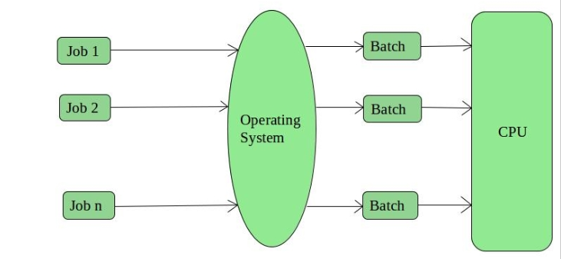
Continued…

Slide 14
Advantages of Batch Operating System
Most of the time it is very difficult to guess or know the time required by any job to complete.
But in the case of Batch OS:-
Processors of the batch systems know how long the job would be when it is in queue.
Multiple users can share the batch systems
The idle time for batch system is very less
It is easy to manage large work repeatedly in batch systems

Slide 15
Disadvantages of Batch Operating System
The computer operators should be well known with batch systems
Batch systems are hard to debug
It is sometime costly
The other jobs will have to wait for an unknown time if any job fails.

Slide 16
2. Time-sharing operating systems
Each task is given some time to execute, so that all the tasks work smoothly.
Each user gets time of CPU as they use single system.
These systems are also known as Multitasking Systems.
The task can be from single user or from different users also.
The time that each task gets to execute is called quantum.
Time sharing is a technique which enables many people, located at various terminals, to use a particular computer system at the same time.
Processor's time which is shared among multiple users simultaneously is termed as time-sharing.
The main difference between Multi programmed Batch Systems and Time-Sharing Systems is that in case of multi programmed batch systems, objective is to maximize processor use, whereas in Time-Sharing Systems objective is to minimize response time.
Multiple jobs are executed by the CPU by switching between them, but the switches occur so frequently.
Thus, the user can receive an immediate response. Examples of Time-Sharing OSs are: Multics, Unix etc.

Slide 17
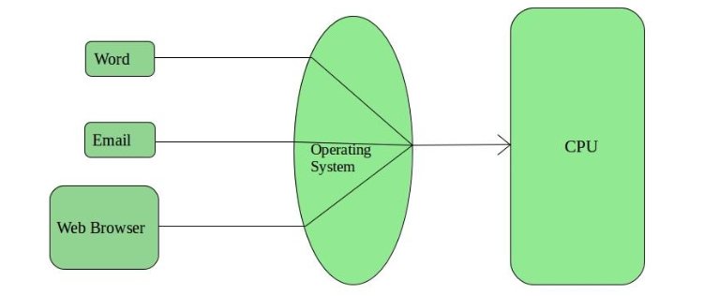
Continued…

Slide 18
Advantages of Timesharing operating systems
Provide advantage of quick response.
Each task gets an equal opportunity
Less chances of duplication of software
CPU idle time can be reduced
Disadvantages of Timesharing
Problem of reliability.
Question of security and integrity of user programs and data.
Problem of data communication.

Slide 19
3. Distributed operating System
Various autonomous interconnected computers communicate each other using a shared communication network or network middleware.
Independent systems possess their own memory unit and CPU. These are referred as loosely coupled systems or distributed systems.
These system’s processors differ in size and function. The major benefit of working with these types of operating system is that it is always possible that one user can access the files or software which are not actually present on his system but on some other system connected within this network.
Distributed systems use multiple central processors to serve multiple real time application and multiple users.
Data processing jobs are distributed among the processors accordingly to which one can perform each job most efficiently.
The processors communicate with one another through various communication lines (such as high-speed buses or telephone lines). Examples of Distributed Operating System is LOCUS.

Slide 20
The advantages of distributed systems are following.
With resource sharing facility user at one site may be able to use the resources available at another.
Speedup the exchange of data with one another.
If one site fails in a distributed system, the remaining sites can potentially continue operating.
Better service to the customers.
Reduction of the load on the host computer.
Reduction of delays in data processing.

Slide 21
Disadvantages of Distributed Operating System:
Failure of the main network will stop the entire communication.
To establish distributed systems the language which are used are not well defined yet.
These types of systems are not readily available as they are very expensive.
Not only that the underlying software is highly complex and not understood well yet.

Slide 22
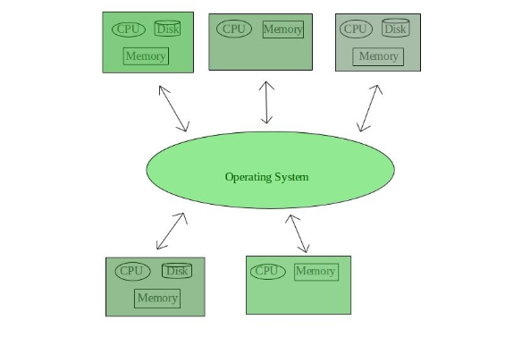
Cont…

Slide 23
4. Network operating System
Network Operating System runs on a server and provides server the capability:-
to manage data, users, groups, security, applications, and other networking functions.
The primary purpose of the network operating system is to allow shared file and printer access among multiple computers in a network,
typically a local area network (LAN), and a private network or to other networks.
Examples of network operating systems are Microsoft Windows Server 2003, Microsoft Windows Server 2008, UNIX, Linux, Mac OS X, Novell NetWare, and BSD.

Slide 24
The advantages of network operating systems are as following.
Centralized servers are highly stable.
Security is server managed.
Upgrades to new technologies and hardware can be easily integrated into the system.
Remote access to servers is possible from different locations and types of systems.
But the disadvantages is:-
High cost of buying and running a server.
Dependency on a central location for most operations.
Regular maintenance and updates are required.

Slide 25
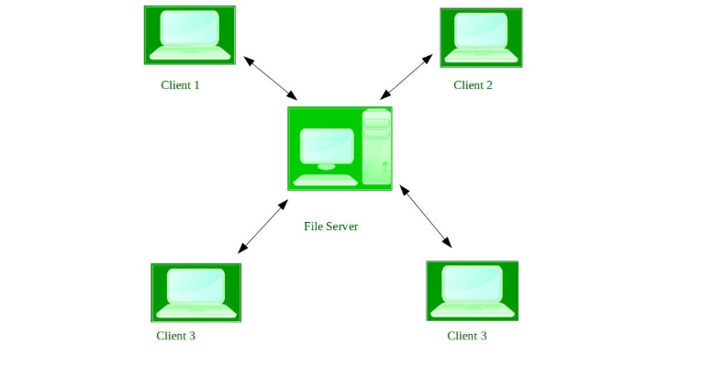
Cont…

Slide 26
5. Real Time operating System
Real time system is defined as a data processing system in which the time interval required to process and respond to inputs is so small that it controls the environment.
This time interval is called response time.
Real time processing is always on line whereas on line system need not be real time.
The time taken by the system to respond to an input and display of required updated information is termed as response time.
So in this method response time is very less as compared to the online processing.
Examples of Real-Time Operating Systems are: Scientific experiments, medical imaging systems, industrial control systems, weapon systems, robots, air traffic control systems, etc.
There are two types of real-time operating systems.

Slide 27
Hard real-time and Soft real-time systems
Hard real-time systems(immediate real-time system) guarantee that critical tasks complete on time. Hard real time systems uses preemptive version of priority scheduling, so that critical tasks get immediately scheduled.
Hard real-time means you must absolutely hit every deadline. Very few systems have this requirement. Some examples are nuclear systems, some medical applications such as pacemakers.
Soft real time systems are less restrictive. Critical real-time task gets priority over other tasks and retains the priority until it completes.
Soft real time systems uses non-preemptive version of the priority scheduling, which allows the present task to be finished before control is transferred to the higher priority task.
soft real time systems can miss some deadlines, but eventually performance will degrade if too many are missed.
Soft real-time systems have limited utility than hard real-time systems.

Slide 28
Advantages of RTOS:
Maximum Consumption: Maximum utilization of devices and system, thus more output from all the resources
Task Shifting: Time assigned for shifting tasks in these systems are very less. For example in older systems it takes about 10 micro seconds in shifting one task to another and in latest systems it takes 3 micro seconds.
Focus on Application: Focus on running applications and less importance to applications which are in queue.
Error Free: These types of systems are error free.
Memory Allocation: Memory allocation is best managed in these type of systems.

Slide 29
Disadvantages of RTOS:
Limited Tasks: Very few tasks run at the same time and their concentration is very less on few applications to avoid errors.
Use heavy system resources: Sometimes the system resources are not so good and they are expensive as well.
Complex Algorithms: The algorithms are very complex and difficult for the designer to write on.
Device driver and interrupt signals: It needs specific device drivers and interrupt signals to response earliest to interrupts.
Thread Priority: It is not good to set thread priority as these systems are very less prone to switching tasks.

Slide 30
Operating System services
An Operating System provides services to both the users and to the programs.
It provides programs, an environment to execute.
It provides users, services to execute the programs in a convenient manner.

Slide 31
Generally os is :-
Loads a program into memory.
Executes the program.
Handles program's execution.
Provides a mechanism for process synchronization.
Provides a mechanism for process communication.
Provides a mechanism for deadlock handling.
Manage I/O operations
Error Detection
For security
Resource Allocation

Slide 32


